Slide 1
Great Britain
Authors: Joachim Szwanc, Jakub Stryczek, Piotr Dziewic, Anna Chmielowska, Katarzyna Kolek

Slide 2
Day #1

Slide 3
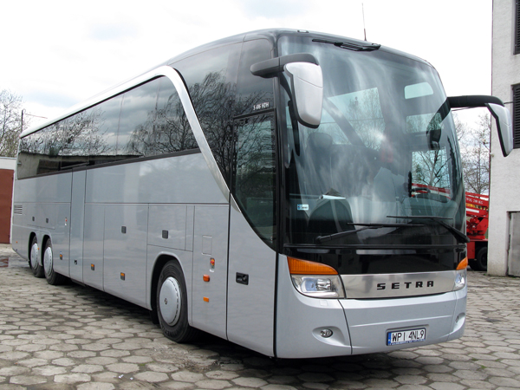
Journey to the destination

Slide 4
Day #2

Slide 5
In the early morning of the day #2, we arrived to Calais and crossed the La Manche.

Slide 6
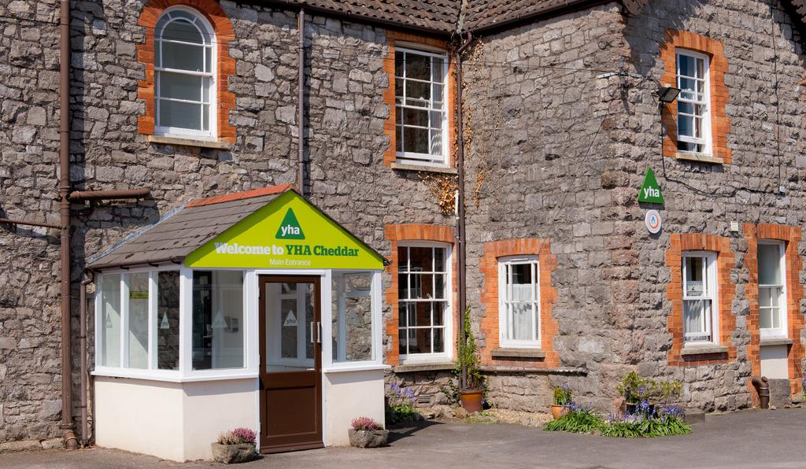
YHA Cheddar
In the evening of that day we accomodated in our hostel.

Slide 7
Day #3

Slide 8
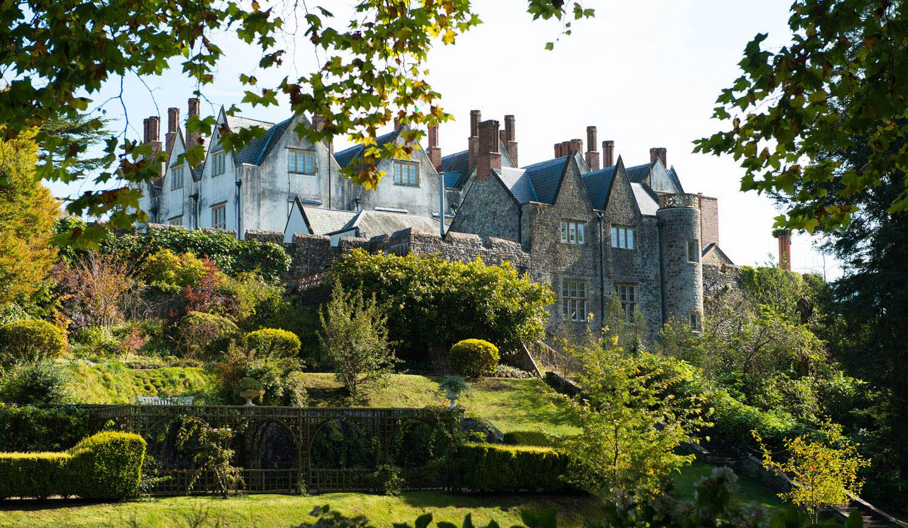
St Fagans
The first attraction of the day was sightseeing an open-air museum in the vicinity of Cardiff.

Slide 9
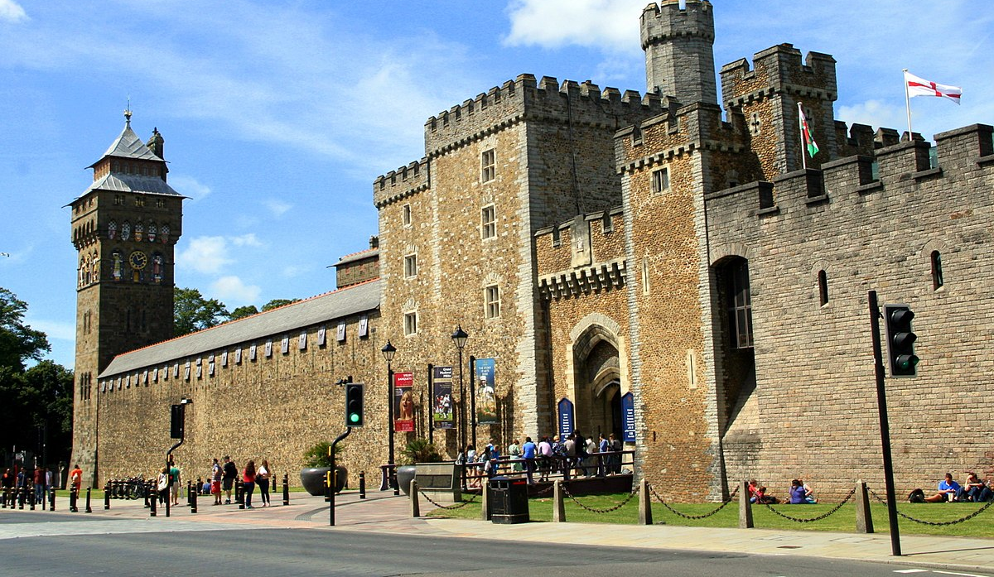
Cardiff
On our tour in Cardiff we were led by an English speaking guide who showed us the city from the inhabitant’s point of view.

Slide 10
Day #4

Slide 11
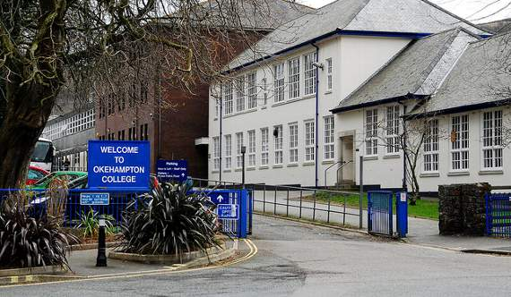
Okehampton College
On day #4 we had an opportunity to see in what way English teenagers acquire knowledge. We have to admit that we were a bit jealous.

Slide 12
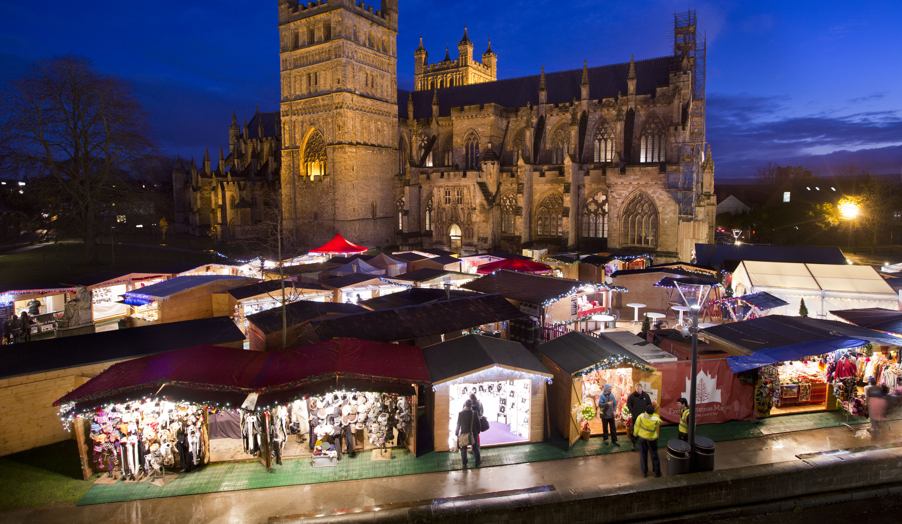
Exeter
In the evening we walked around the Christmas market and the city centre of Exeter.

Slide 13
Day #5

Slide 14
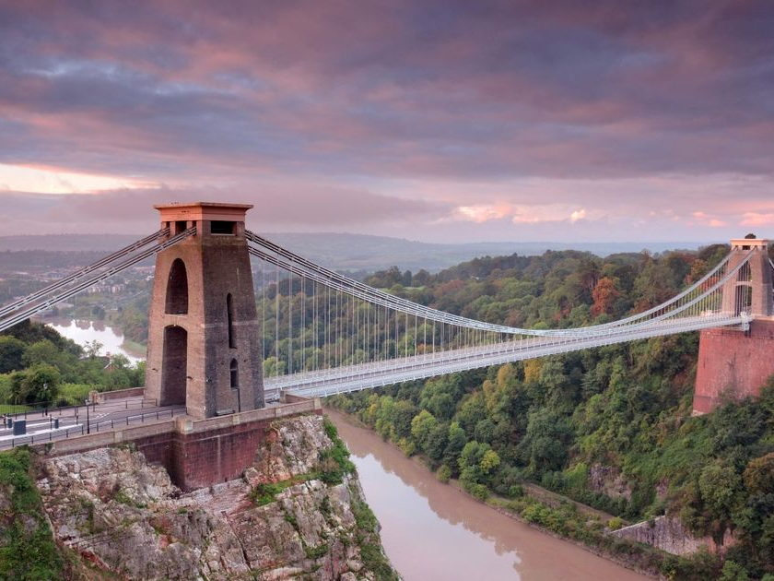
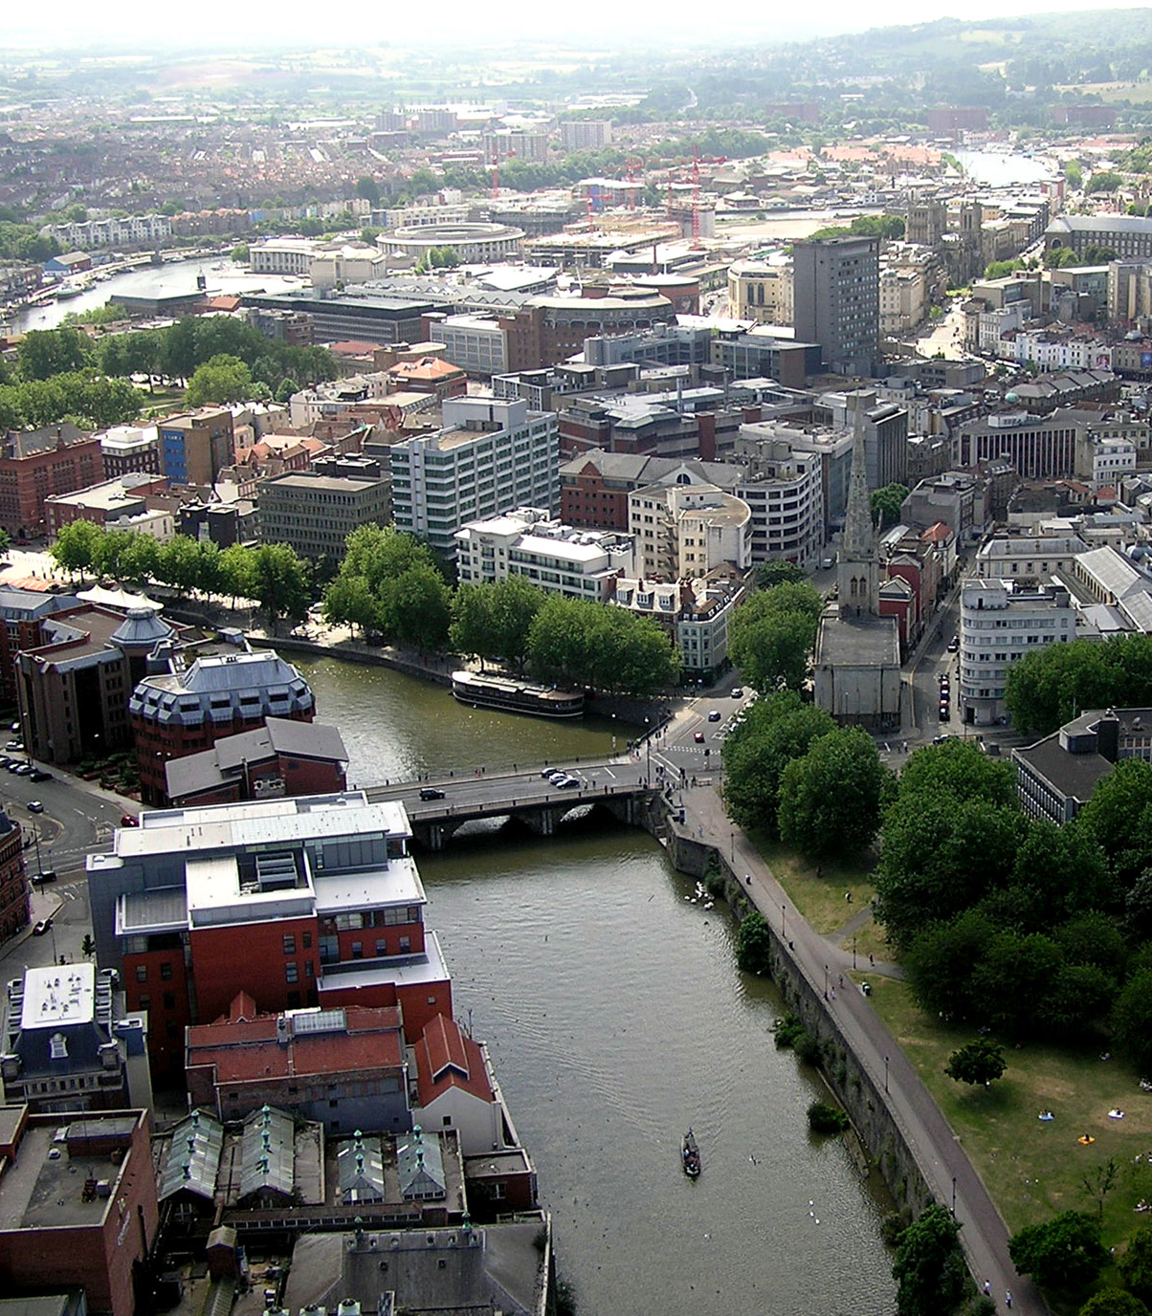
Bristol

Slide 15
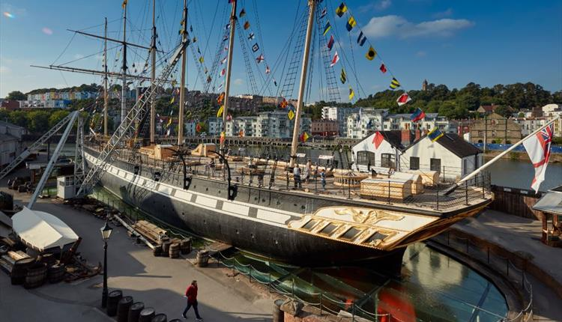
SS Great Britain
SS Great Britain – a museum ship and former passenger ship which used to be the longest passenger ship in the world from 1845 to 1854.

Slide 16
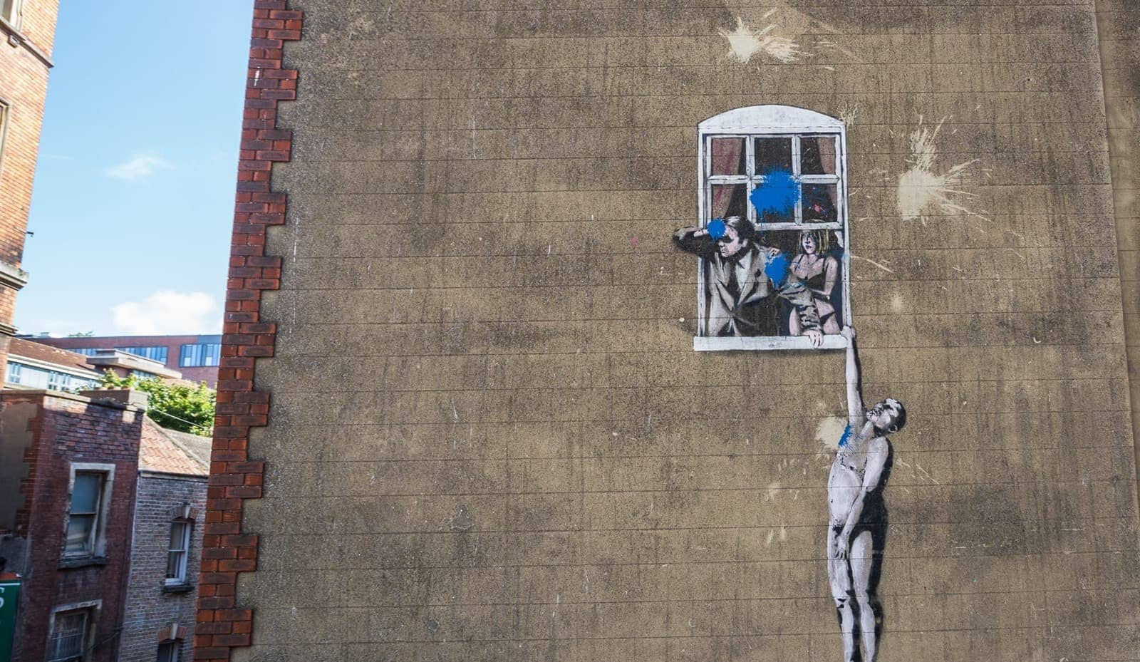
Bristol street art
Bristol is the city of the most famous graffiti artist such as Banksy. Here are also organised graffiti contests in which artists from the whole world take part.

Slide 17
Day #6

Slide 18
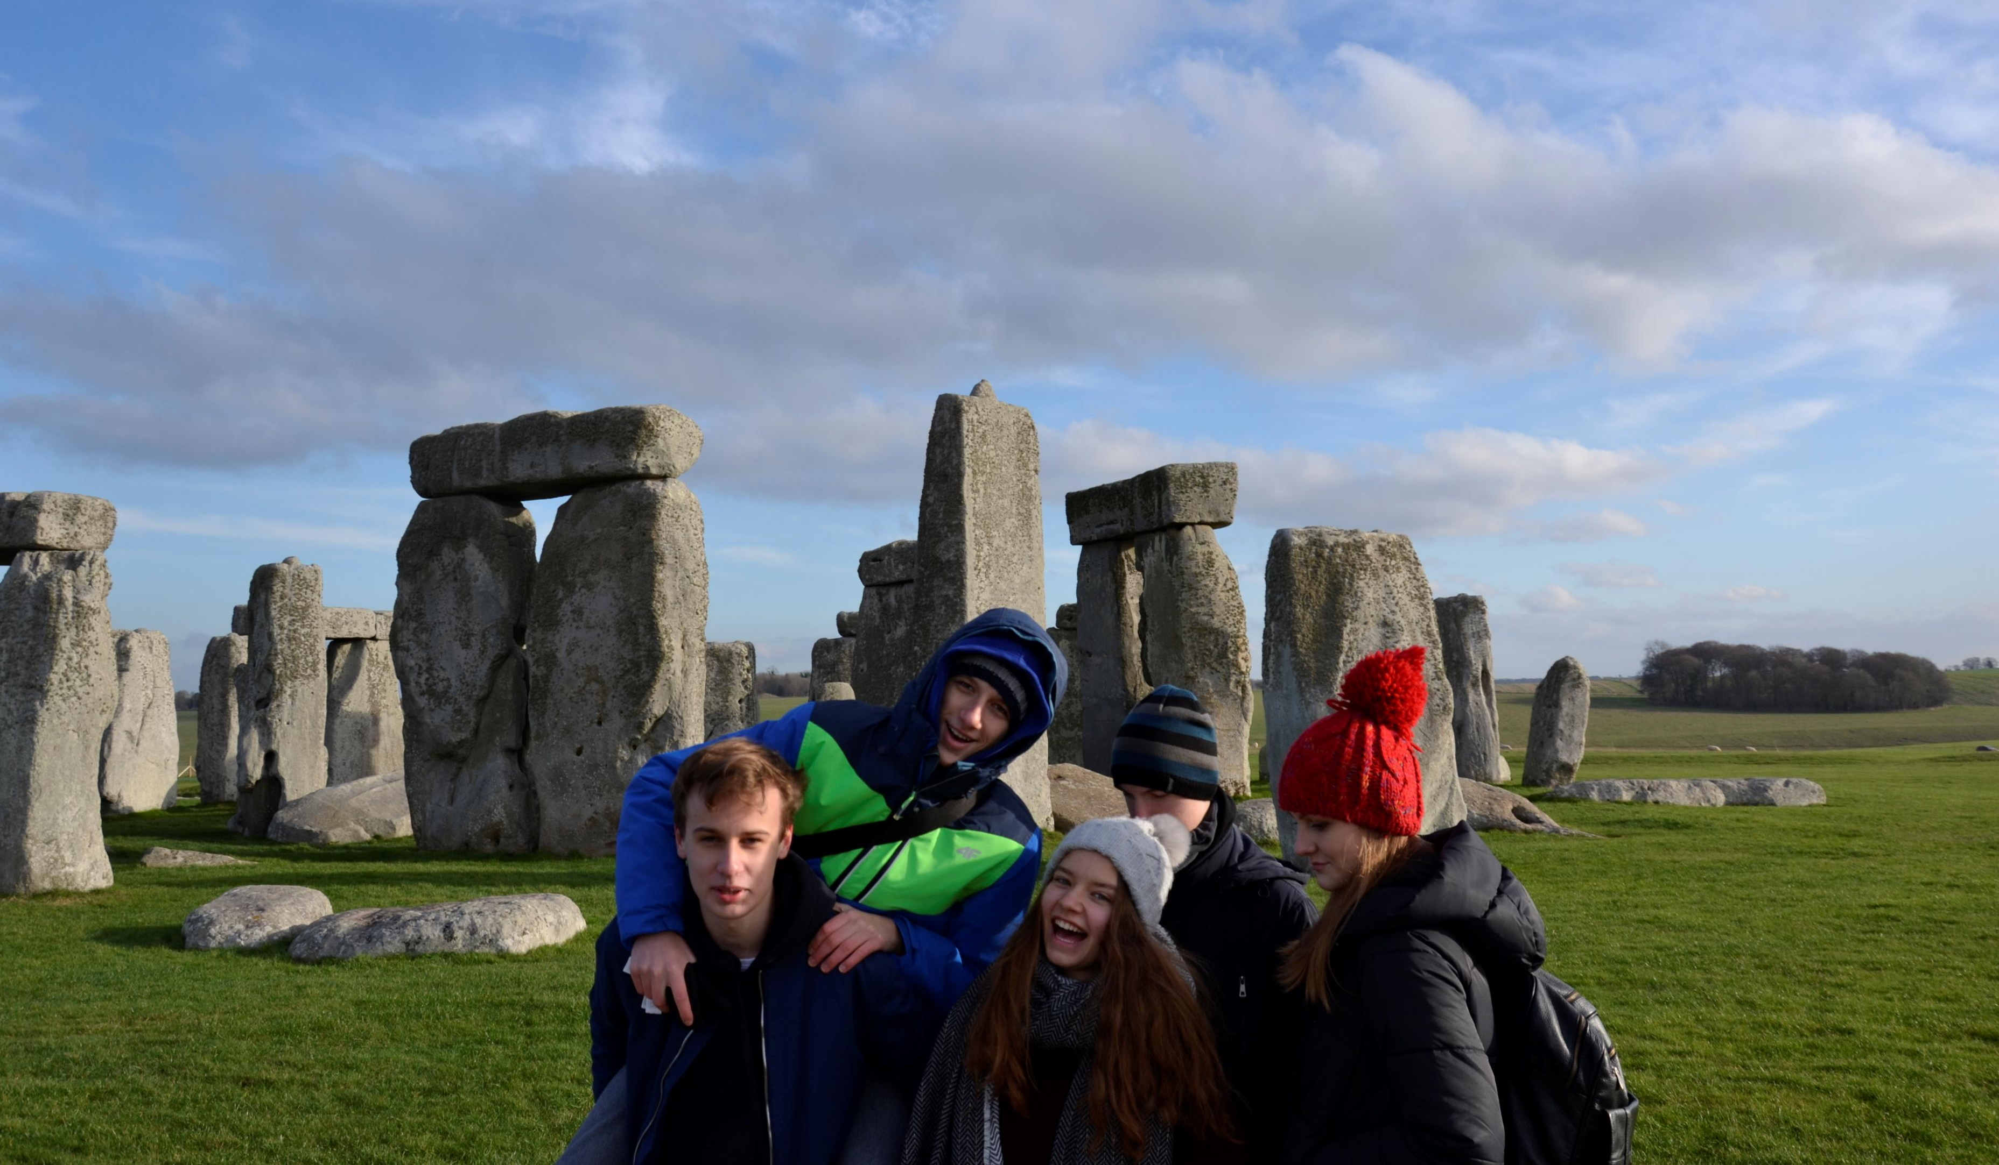
Stonehenge
The most iconic prehistoric monument in the world.

Slide 19
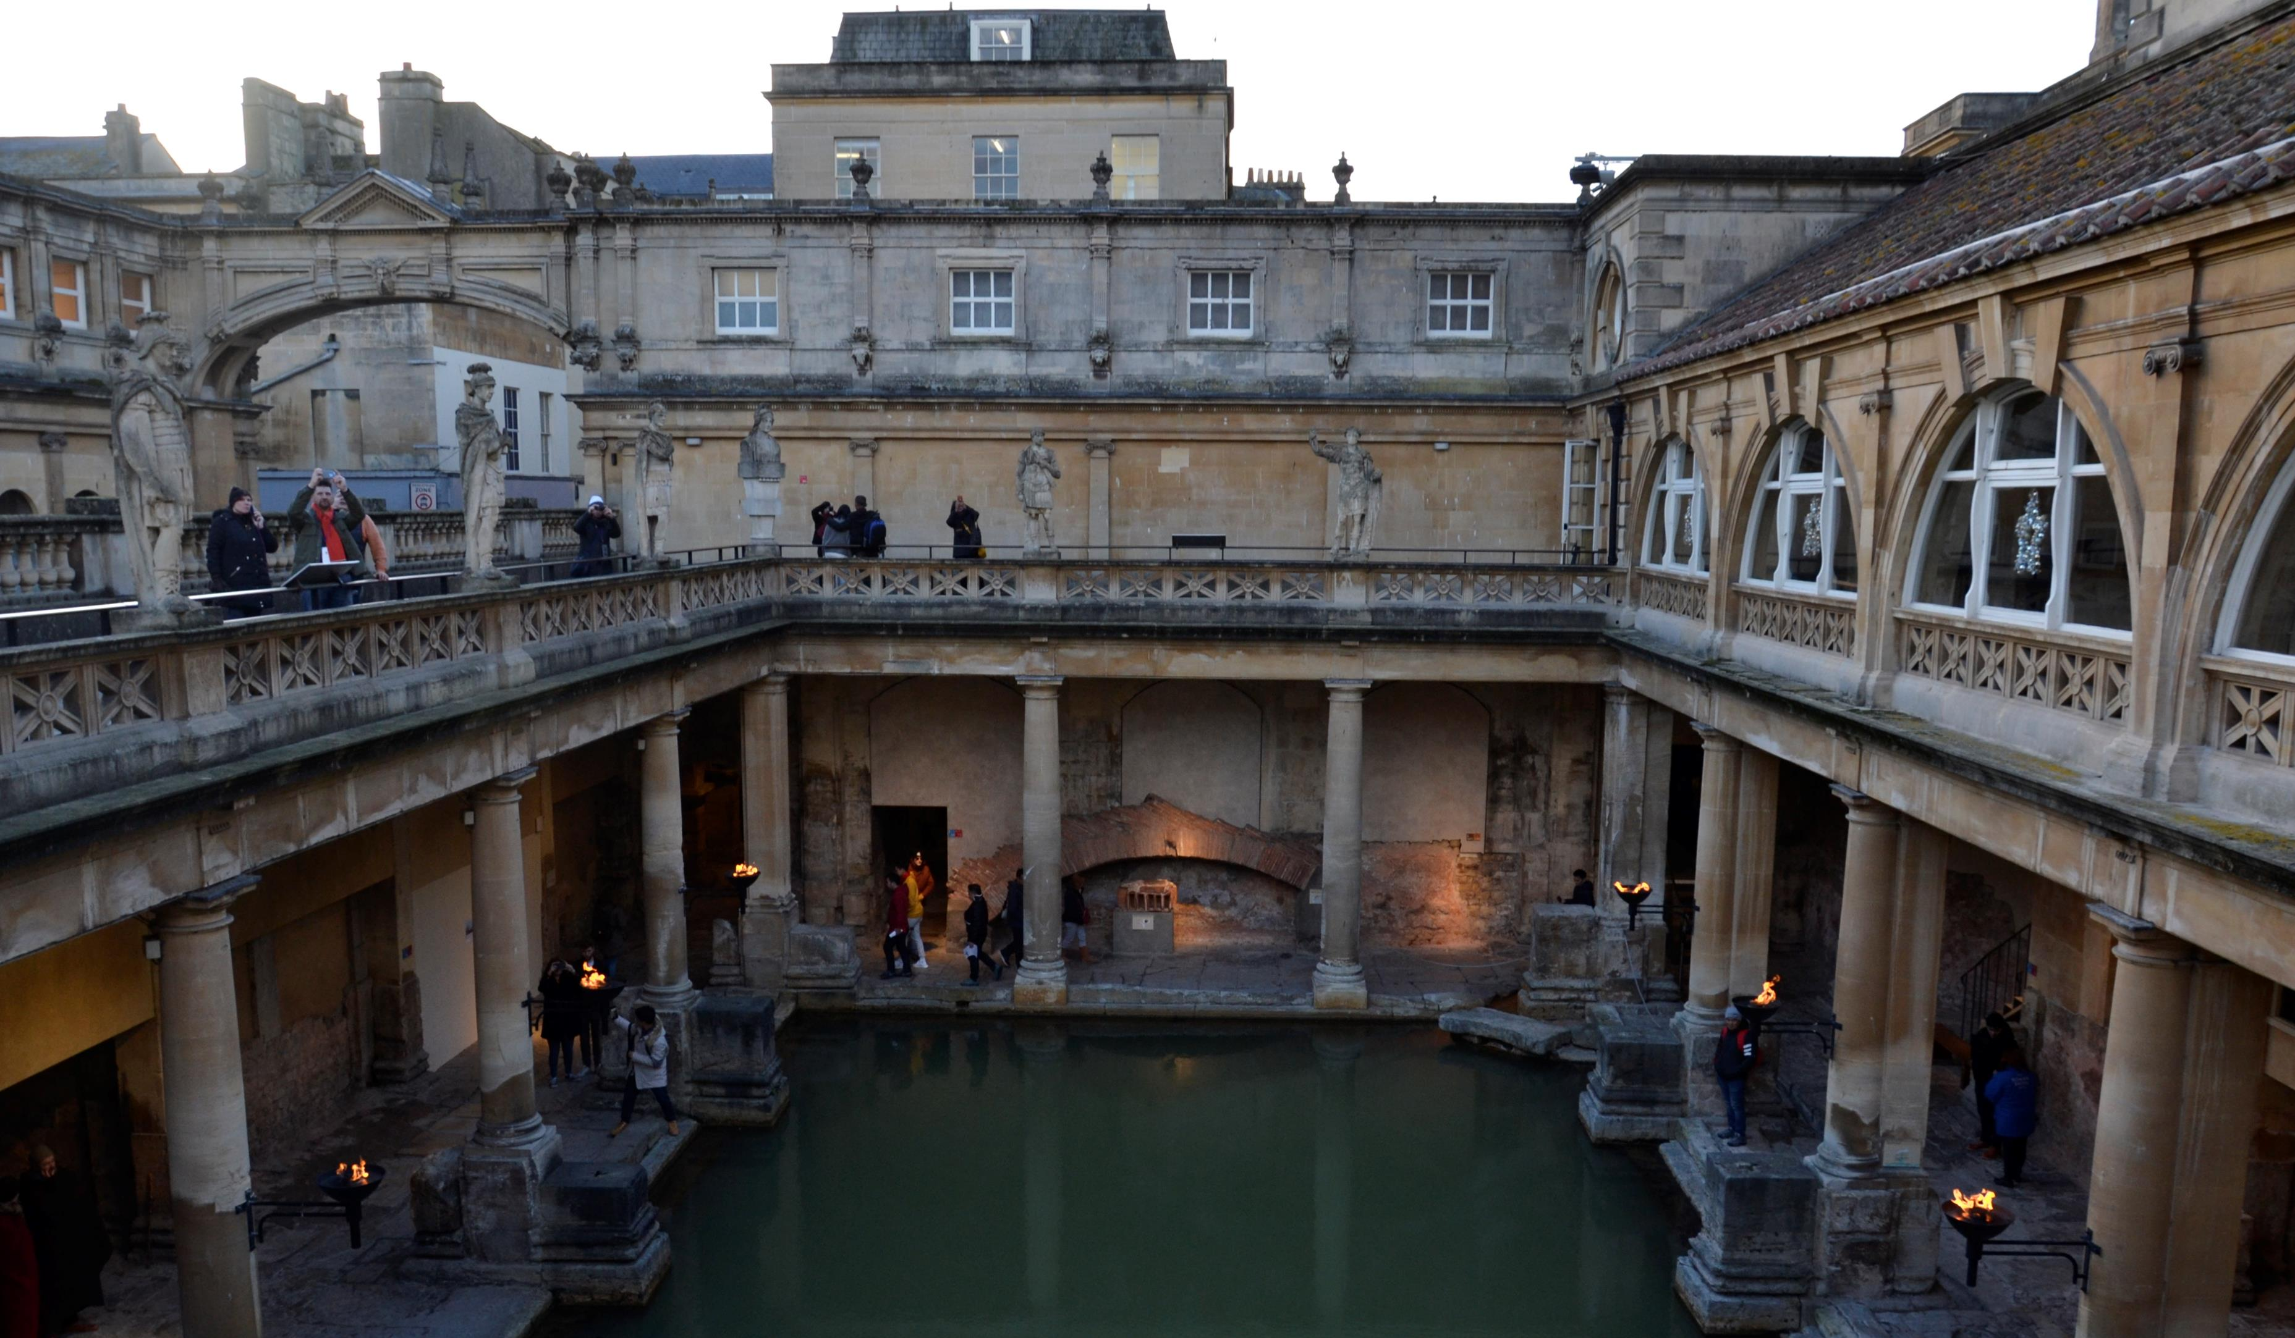
Bath
During our stay in Bath we visited Roman Baths which is a complex of historical interest and walked around through best known streets in the city.

Slide 20
Day #7

Slide 21
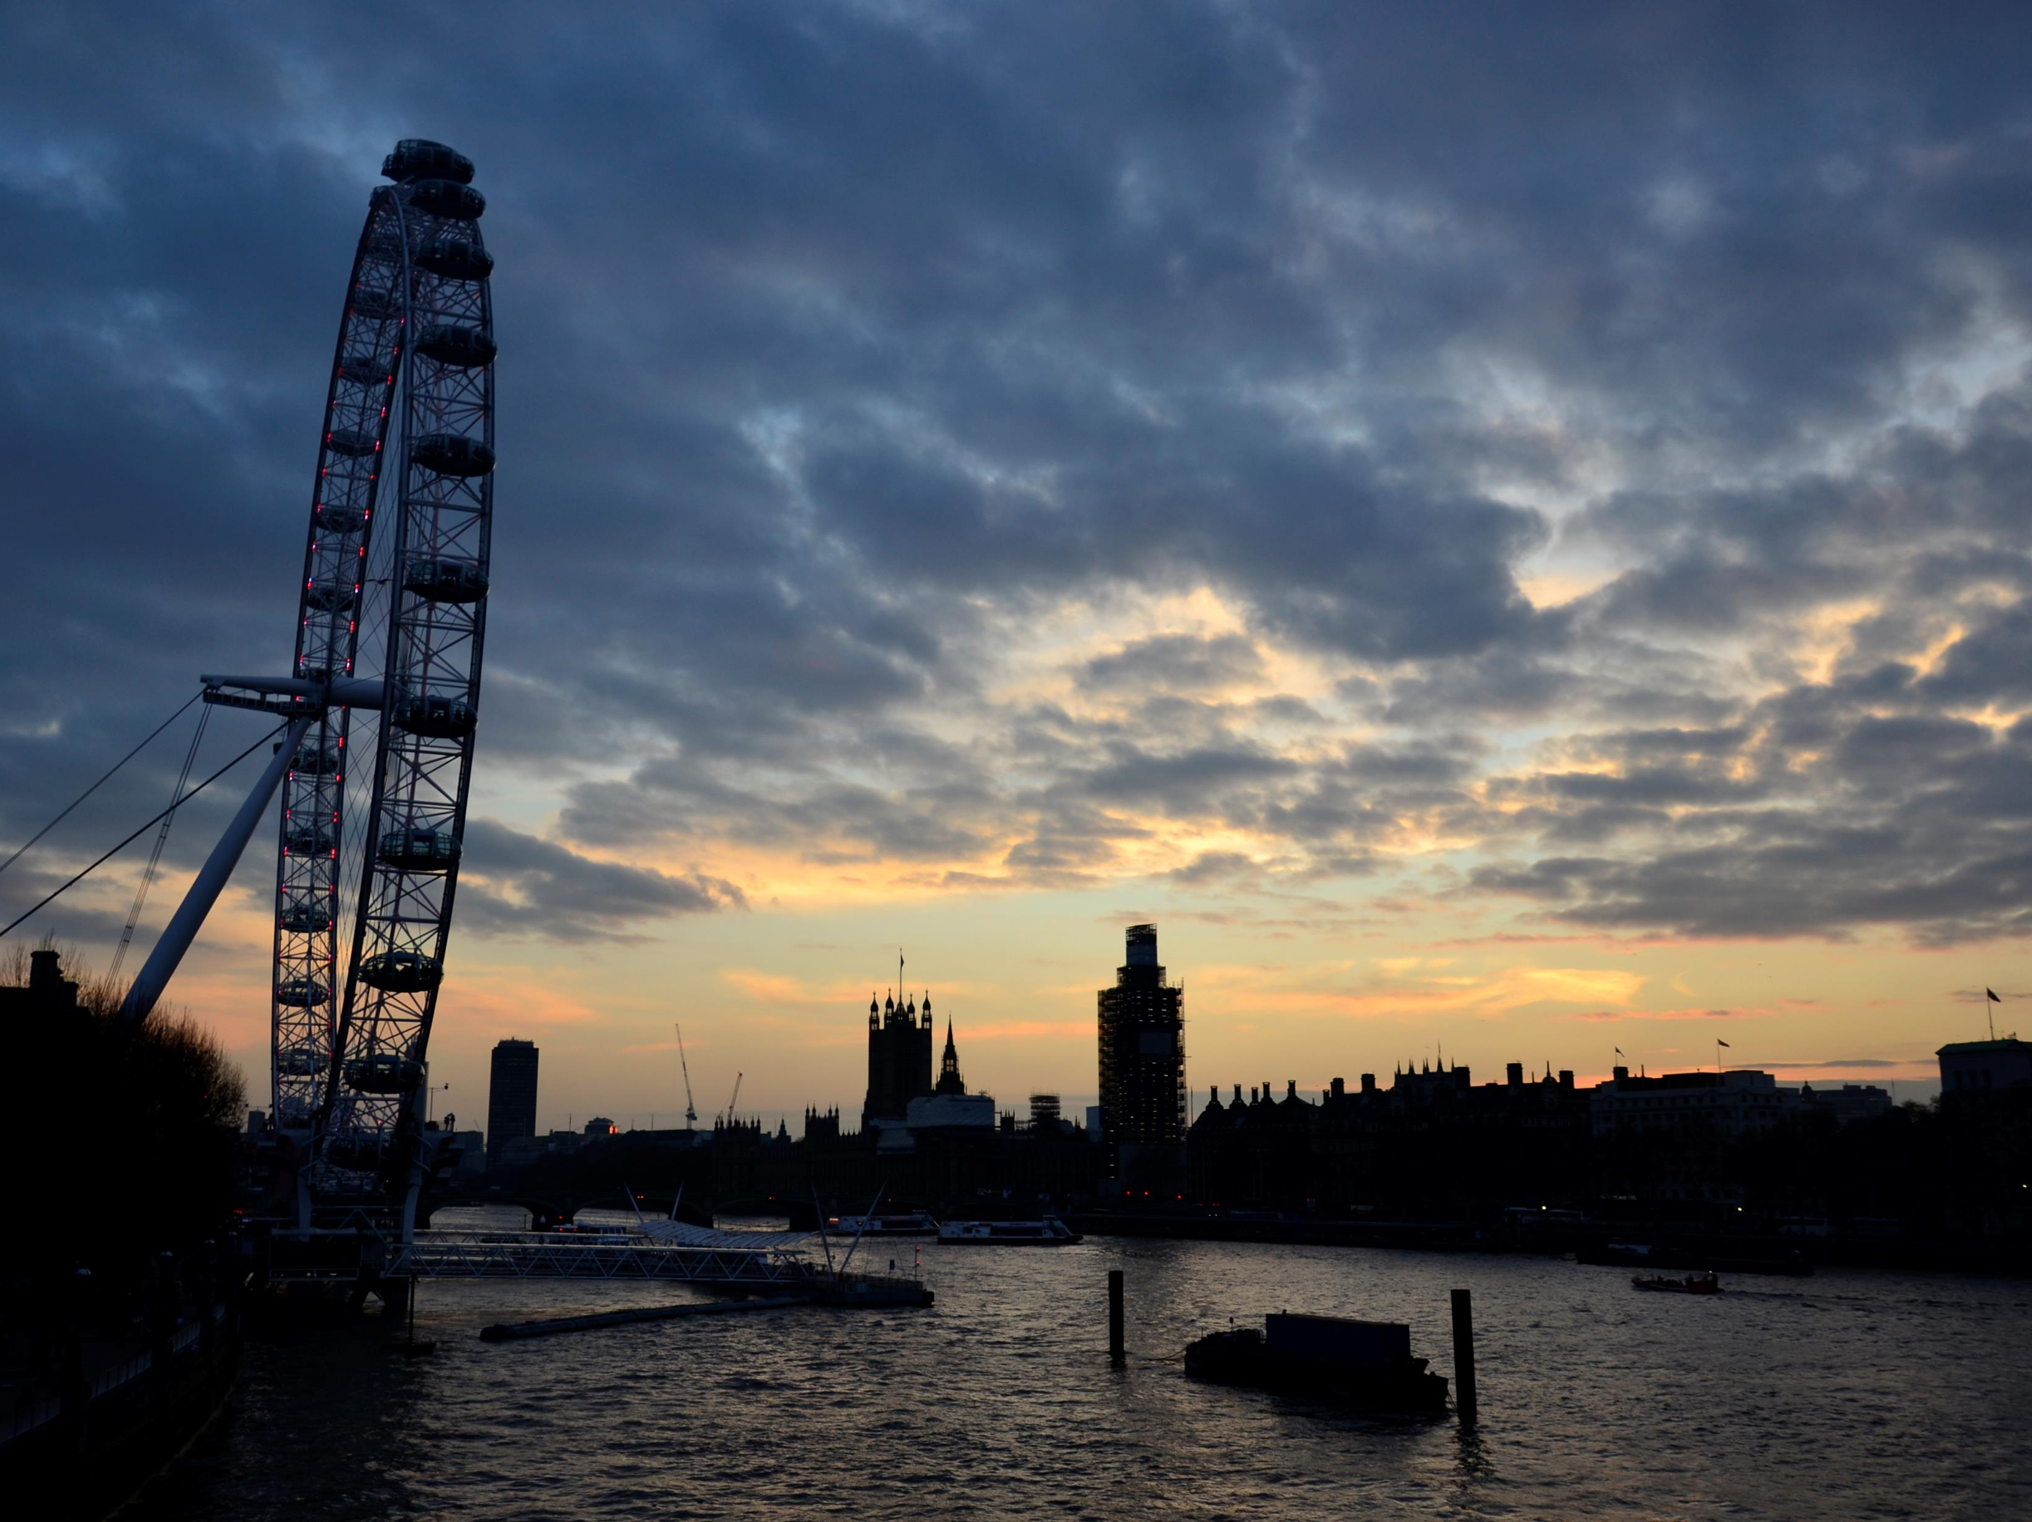
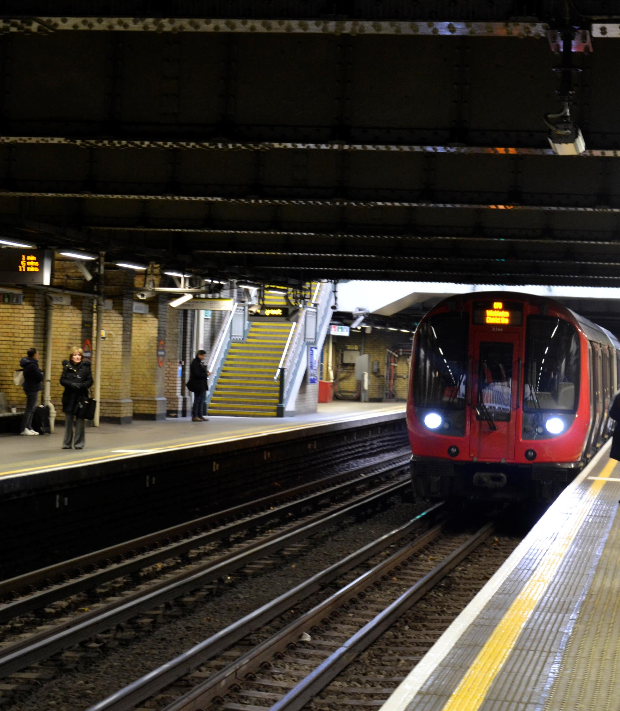
London – The capital of England

Slide 22
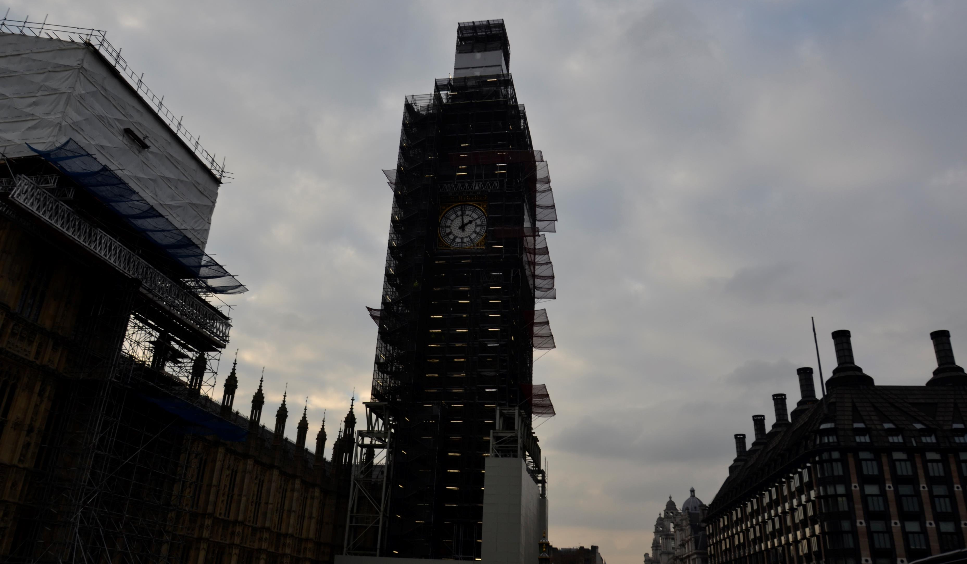
Big Ben
The most iconic bell whose name is extended to both the clock and the clock tower. Unfortunately it was hidden behind scaffolding :(

Slide 23
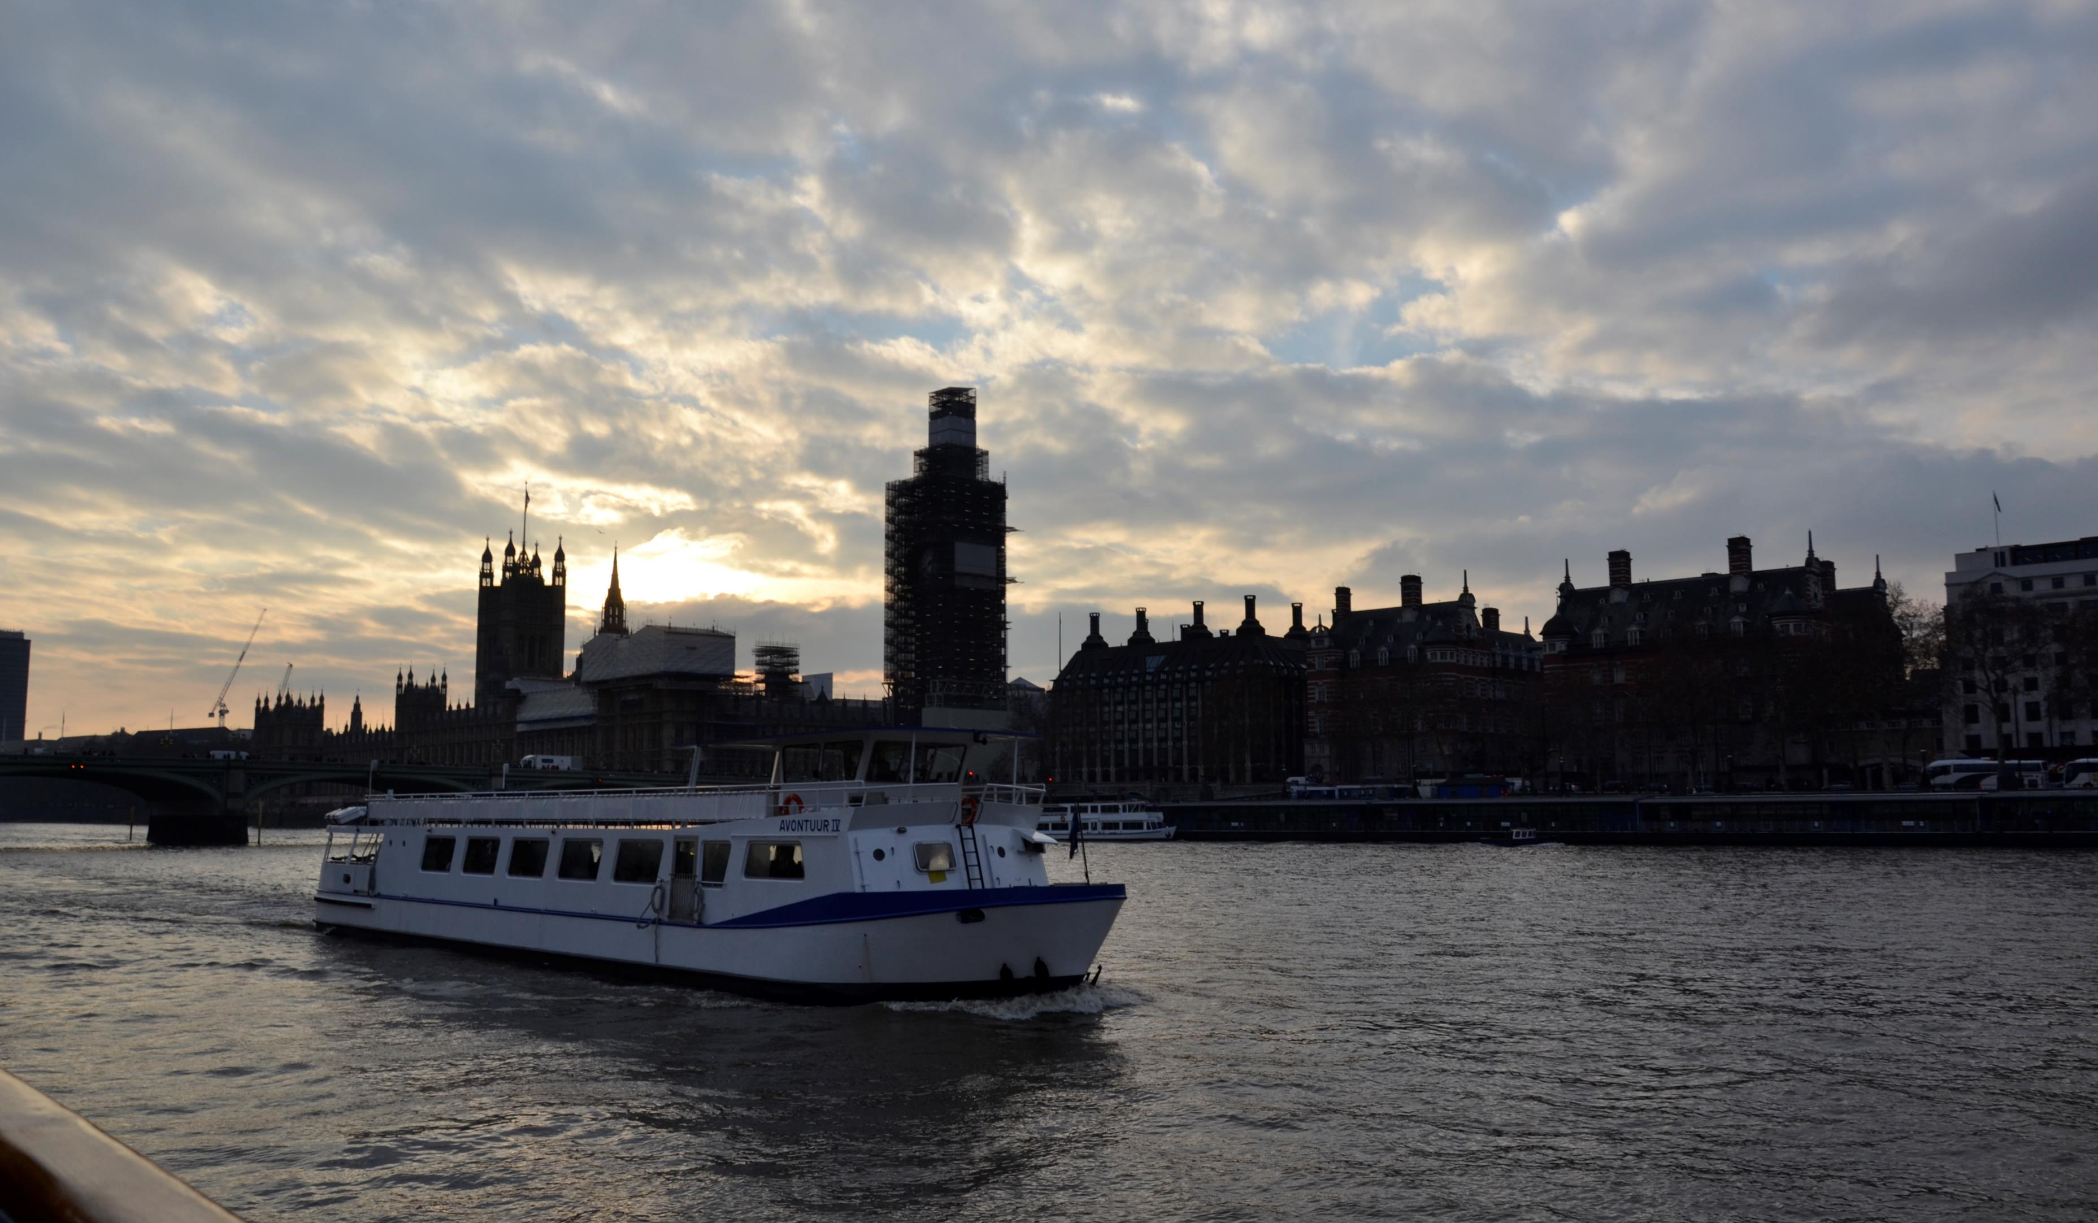
Thames River Cruise
During the Thames River Cruise we have seen the most popular buildings located in the river vicinity.

Slide 24
In the evening we watched „Bat out of Hell” –a musical in the London West End Theatre.

Slide 25
Returned to poland
Late in the evening of that day we set off back to Poland which also took us the whole next day.

Slide 26
The End

